Slide 1


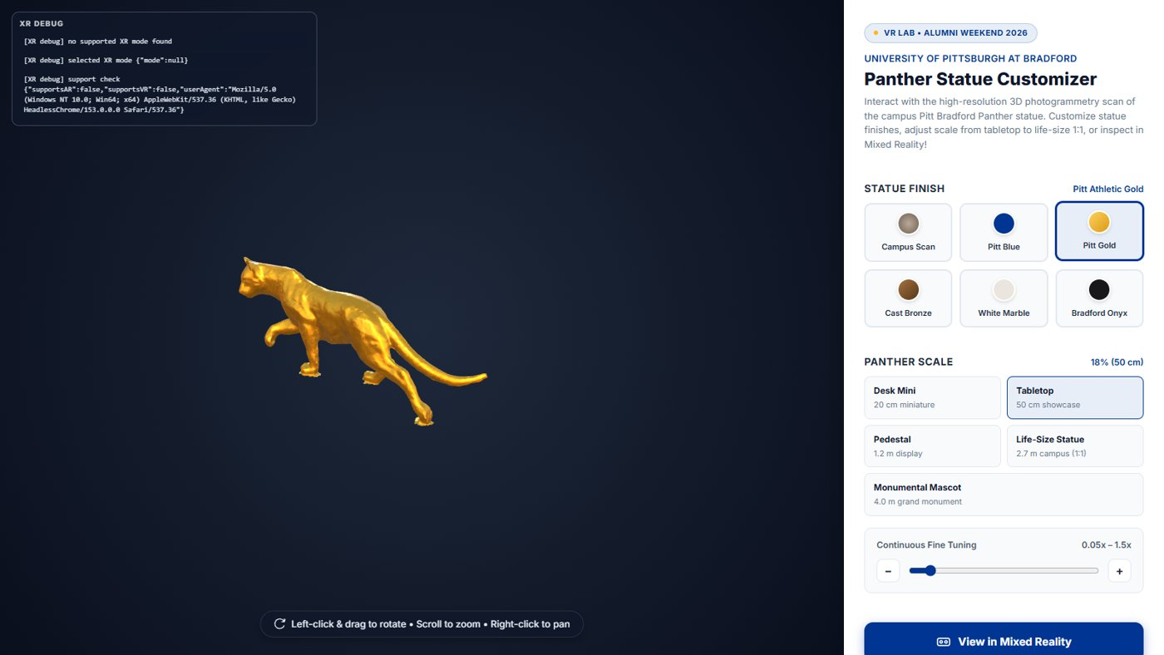

Virtual Reality
AR Development I: the AR landscape and a first AR Foundation scene
Wednesdays at 6:00pm
CIST 1423 - 2010 VIRTUAL REALITY PROGRAMMING AND TECHNOLOGY
Lab: build a starter AR Foundation scene and place a cube
Notes:
Syllabus Week 6. Next week (normally AR II) is WebXR building instead, so this week carries the core AR concepts.

Slide 2



Agenda
The AR landscape
AR Foundation setup
Place a cube
Phones, headsets, marker vs markerless
Packages, XR Plug-in Management, the session objects
Your first object in the real world

Slide 3

Today
By the end of class you can…
Compare handheld AR, passthrough MR and optical see-through
Tonight's plan
1
0–10
Review
Tell marker-based from markerless AR, and name the AR Foundation manager for each
2
10–40
AR landscape + AR Foundation setup
40–50
Lab briefing
Set up an AR Foundation project (packages, XR Plug-in Management, AR Session, XR Origin)
3
50–130
Lab: starter AR scene + place a cube
Place a cube in the real world at the right scale
130–145
Share-out
4
145–150
Exit ticket
CIST 1423 — Week 6 — AR Development in Unity I (Ch. 4, first half)

Slide 4
The AR landscape
Same idea everywhere: track the device, understand the room, draw on top of reality.
Kind | Devices | How you see reality | We have
Handheld AR | Android (ARCore), iPhone/iPad (ARKit) | Camera feed on a screen | Your phones
Passthrough MR | Quest 3 / Quest Pro, Vision Pro | Cameras → headset displays | Quest (lab)
Optical see-through | HoloLens 2, Magic Leap | Transparent lenses | HoloLens (stage)
Web AR | Quest Browser, Chrome Android | WebXR immersive-ar | panther-builder / WaterWorks
VR replaces the world. AR adds to it. MR additionally understands it (planes, meshes, anchors).
CIST 1423 — Week 6 — AR Development in Unity I (Ch. 4, first half)

Slide 5


Marker-based vs markerless
How does the app know where to put things?
Marker-based (image tracking)
Markerless (SLAM)
Recognise a known picture: poster, card, QR
Content locks to the marker
Great for museum labels, product boxes
AR Foundation: ARTrackedImageManager
Tracks feature points in any scene
Finds planes: floors, tables, walls
Place anywhere, anchor to the world
AR Foundation: ARPlaneManager, ARRaycastManager, ARAnchorManager
Campus idea: a marker on the Panther statue's plaque that spawns our scanned Panther model next to it.
CIST 1423 — Week 6 — AR Development in Unity I (Ch. 4, first half)

Slide 6
Lab: set up an AR Foundation project
Unity 2022.3 LTS. Build target Android (or iOS on a Mac).
1. Template
2. Packages
3. XR Plug-in Mgmt
4. Session objects
5. Test
Unity Hub → New → "AR Mobile" template, or 3D (URP) and add packages yourself.
Package Manager: AR Foundation + Google ARCore XR Plugin (Android) / Apple ARKit XR Plugin (iOS).
Android tab: check ARCore. Player Settings: min API 24+, remove Vulkan, IL2CPP + ARM64.
Delete Main Camera. GameObject → XR → AR Session, and XR Origin (AR).
Build & Run to a phone. Or use XR Simulation (AR Foundation 5+) in the Editor.
CIST 1423 — Week 6 — AR Development in Unity I (Ch. 4, first half)
Notes:
The textbook shows "AR Session Origin"; in AR Foundation 5+ it is "XR Origin (AR)". Same job.

Slide 7



AR Session and XR Origin (was AR Session Origin)
Two GameObjects every AR Foundation scene needs.
AR Session
XR Origin (AR)
Scale and units
Turns AR on and off for the whole app
Owns tracking state (none / limited / tracking)
Exactly one per scene
The "rig": maps device space to Unity space
Contains the AR Camera (camera feed + pose)
Where trackable managers live (planes, raycasts, anchors)
1 Unity unit = 1 metre in the real world
A default cube is 1 m: scale it to 0.1 for a tabletop cube
CIST 1423 — Week 6 — AR Development in Unity I (Ch. 4, first half)

Slide 8


Placing a simple cube
Simplest version: put a 10 cm cube 50 cm in front of the camera when AR starts tracking.
using UnityEngine;
using UnityEngine.XR.ARFoundation;
public class PlaceCubeOnStart : MonoBehaviour
{
public Transform arCamera; // the AR Camera under XR Origin
bool placed;
void Update()
{
// Wait until the device is actually tracking the room
if (placed || ARSession.state != ARSessionState.SessionTracking) return;
var cube = GameObject.CreatePrimitive(PrimitiveType.Cube);
cube.transform.localScale = Vector3.one * 0.1f;
cube.transform.position = arCamera.position + arCamera.forward * 0.5f;
placed = true;
}
}
Why wait for tracking?
Before tracking, the camera pose is 0,0,0
The cube would appear in the wrong place
Next step
Tap a detected plane to place instead (ARRaycastManager)
We do that in WebXR next week with hit-test
CIST 1423 — Week 6 — AR Development in Unity I (Ch. 4, first half)

Slide 9
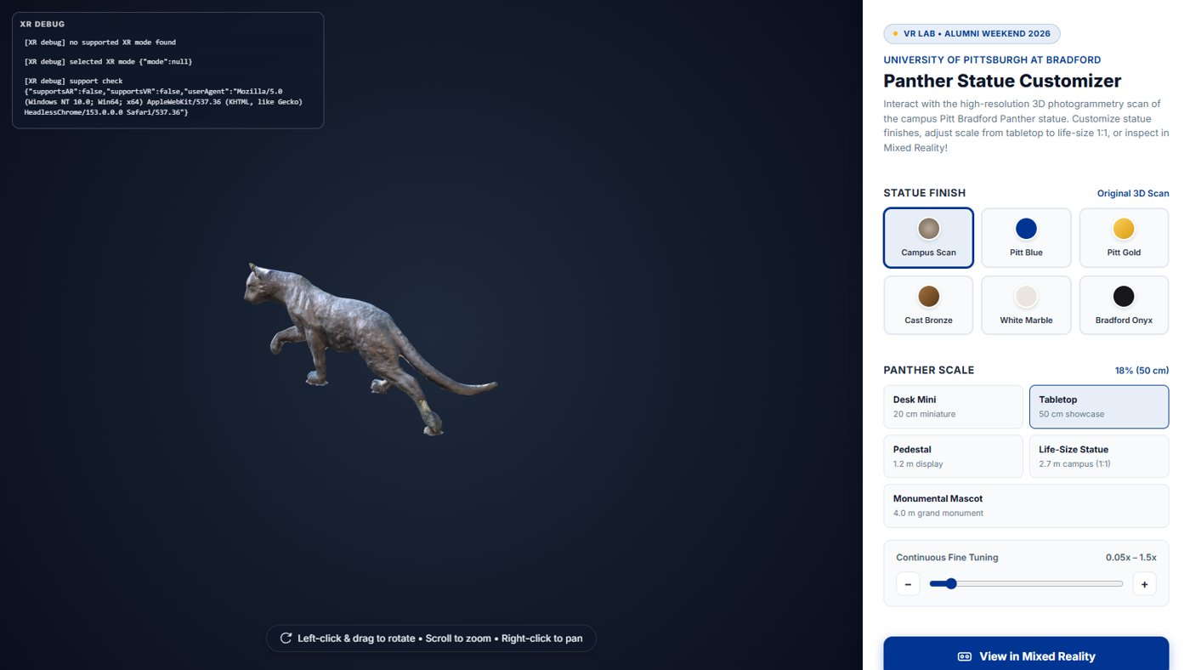
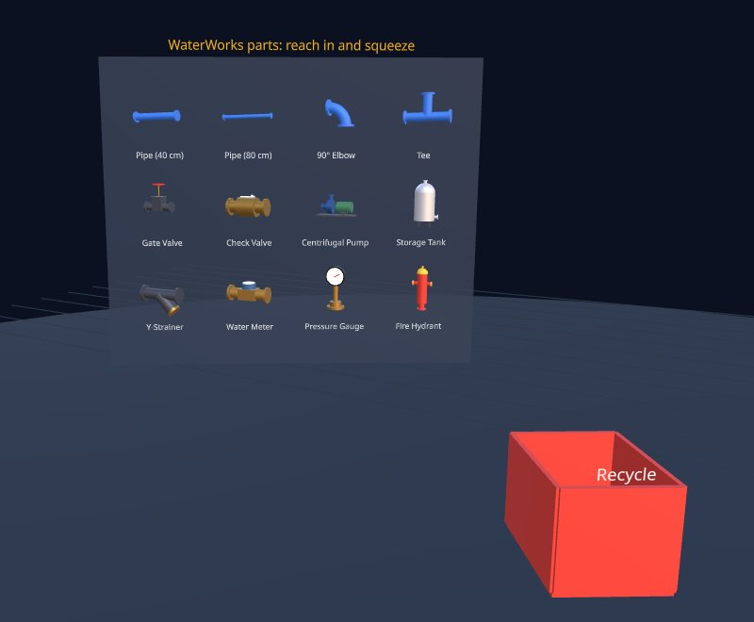
AR on the web: the same ideas
The panther-builder we showed at Alumni Weekend is web AR: immersive-ar on a Quest with passthrough.
panther-builder on a laptop: same code, no AR. The 3D viewer is the fallback.
Next week's WaterWorks shelf: in MR it floats in your real room.
WebXR asks for the same features AR Foundation has: hit-test (raycasts), plane-detection, anchors.
CIST 1423 — Week 6 — AR Development in Unity I (Ch. 4, first half)

Slide 10
Check your understanding
Answer with a partner first, then we'll compare.
Q1
Q2
What does the AR Session object do? What does XR Origin do?
Your default cube looks huge on the table. Why?
Q3
Q4
Which manager for "tap to place on a floor"?
What's the WebXR name for the same idea?
CIST 1423 — Week 6 — AR Development in Unity I (Ch. 4, first half)
Notes:
Answers:
Q1. What does the AR Session object do? What does XR Origin do?
AR Session turns AR on/off and owns tracking state; XR Origin maps device space to Unity space and holds the AR Camera and managers.
Q2. Your default cube looks huge on the table. Why?
1 Unity unit = 1 metre. A default cube is 1 m, so scale it to 0.1.
Q3. Which manager for "tap to place on a floor"?
ARRaycastManager (against planes found by ARPlaneManager).
Q4. What's the WebXR name for the same idea?
The hit-test feature (XRHitTestSource).

Slide 11

Next steps: homework + planning
Submit your AR scene with a placed object (screenshot or phone video)
Markdown reflection: what AR Session and XR Origin each do in your scene
Next week: WebXR building (replaces AR Development II), bring a laptop and headset
CIST 1423 — Week 6 — AR Development in Unity I (Ch. 4, first half)

